Slide 1
Upscaling Basic Sanitation for the Urban Poor (UBSUP)
Introduction into DTF Construction Manual

Slide 2
Content
Questions you might to ask yourself:
What is the purpose of the “DTF Construction Manual”?
How shall it be used?
What is the structure & content of the manual?

Slide 3
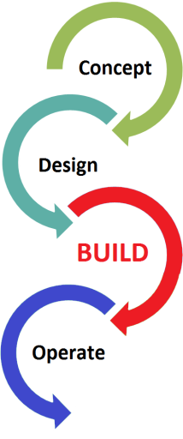
What is the purpose of the manual?
Manual is one from a series of three manuals covering the following aspects of a DTF project cycle:
DTF Design Adaptation (provided in last training)
DTF Construction
DTF Operation & Maintenance (O&M)
Manual is supposed to support Water Service Providers (WSPs) with the implementation of DTF projects

Slide 4
What is the purpose of the manual?
All information and directions provided in the manual shall
Serve as guideline for the Water Company as well as the Contractor (target groups)
Facilitate the tendering, procurement and monitoring processes
Facilitate the construction of a DTF
Ensure that construction quality is in line with all requirements
Ensure that the DTF operates as per design and sustainably

Slide 5
What is the purpose of the manual?
The manual shall be studied by Water Companies and Contractors prior to start of construction to have a common understanding and run into the same direction
In case of questions WSTF can be contacted for clarification

Slide 6
What is the structure of the manual?
The manual is an “easy to handle and use” construction guide and serves:
As source of detailed structural drawings to be used for tendering, construction (by Contractors) and construction supervision (by water companies)
As source of detailed Bill of Quantities (BoQs) to be used for tendering and project monitoring
As guide during the construction of DTFs to avoid construction errors
As a collection of templates to be used during tendering and construction monitoring

Slide 7
What is the structure of the manual?
Manual is divided into colour-coded sections for ease of reference

Slide 8
What is the content of the manual?
To be used to get the construction right
Show detailed information to be used during tendering and construction supervision
The drawings provide technical details for all treatment and auxiliary modules that are part of the generic DTF
An electronic version is provided in AutoCAD
Softcopy is supposed to be used for future projects as well as to prepare “as-built” drawings after completion of construction, incl. approved variations

Slide 9
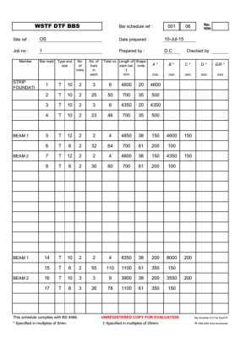
What is the content of the manual?
Complement the structural drawings
Show the shape and lengths of the required reinforcements

Slide 10
What is the content of the manual?
Overview of the BoQ for the treatment and auxiliary modules
Tailor-cut / final BoQ was prepared for a specific DTF during the “Design Adaptation” phase (during this workshop)
Final BoQ shall be used by Water Companies during the tender phase; Contractors are requested to prepare their priced BoQ based on this template
Softcopy of the BoQ is provided in MS-Excel format to be used for preparing the “as-built” BoQ that includes approved variations

Slide 11
What is the content of the manual?
Practical instructions and recommendations related to the construction of DTF
General directions
Detailed recommendations for all treatment modules
Recommendations for construction of auxiliary works
To be used by Contractors and Water Companies to avoid errors during construction

Slide 12
What is the content of the manual?
Basic overview of required measures to avoid / reduce any health & safety risks during the construction of a DTF
Basic safety rules
Emergency response
Specific health and safety examples

Slide 13
What is the content of the manual?
Recommendations and templates to be used by Water Companies during the tender and construction phase
The principal work plan
Weekly and monthly meetings
Daily Report Diary, Monthly Report Diary and Instruction Book
Work measurement, variations, completion of Works and Taking Over of site
Payment Monitoring

Slide 14
Do you have any questions, remarks or suggestions?

